Slide 1
INVESTMENT ASSIGNMENT SUBMISSION
Name: Murali Divya Teja Gummadidala

Slide 2
Spark Funds Investment Case Study
Spark Funds wants to make investments in a few companies.
Spark Funds wants to understand the global trends in investments so that she can take the investment decisions effectively.
Spark Funds has two minor constraints for investments:
It wants to invest between 5 to 15 million USD per round of investment
It wants to invest only in English-speaking countries because of the ease of communication with the companies it would invest in

Slide 3
<Problem solving methodology>
Use flow chart
Selecting Data frame for given sectors
Data Loading and converting to Data frame
Data Cleaning
Combining the data frame and explore EDA
Stop
Showing Analysis in graphs
Getting top 3 performing companies in top3 english speaking countries
Finding the representatives and getting the sectors for 5 to15M USD
Finding the top 9 countries for sector

Slide 4
Analysis
1 . Data Loading checking by checking he type of encodeing
2. Data Merging based on common columns
3. Finding Nulls and Deal with nulls
4. Drop the unwanted Columns
5. Extracting the Finacial Sectors (Venture, seed, angel and private)
6. Getting the right Sector for investing the 5 M to 15 M USD in one of sector
7. Getting the top 3 English communication countries for smooth business
8. Getting the top 3 sector for each English speaking counry
9. Based on analysis Invest in the Particular company

Slide 5
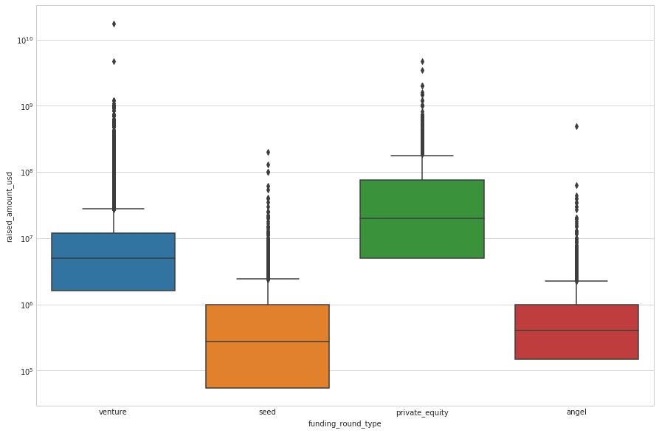
Detection of outlies to find representative value

Slide 6
Fraction of total investments (globally) in venture, seed, and private equity, and the average amount of investment in each funding type

Slide 7
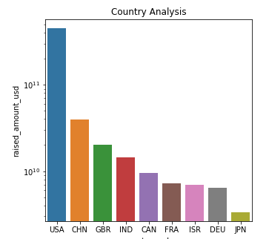
Country analysis in for investment

Slide 8
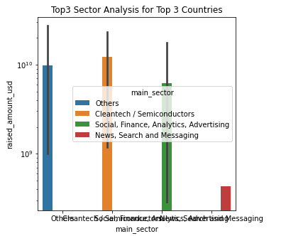
Top 3 sectors for top 3 countries

Slide 9
Conclusions
Based on the data it is clear that USA is the prime place to make investment, going by the number and volume of investments, 50% of the amount can be invested in the top 2 companies on the top 2 sectors shared equally among all 4 companies
Virtustream
Capella
Shotspotter
Demandbase
Next set of investment 25% each can be made at the top company of the top 2 sector in GBR and India respectively
electric-cloud
celltick-technologies
manthan-systems
firstcry-com
Which makes an even share of 12.5% across all the identified 8 companies.
Average total investment across the 8 identified companies as per the data is around 40 million with median between 5-15 million

